Slide 1

HEART DISEASE DIAGNOSTIC ANALYSIS
By sushil maurya

Slide 2
INTRODUCTION
Heart disease remains one of the leading causes of mortality worldwide, underscoring the necessity for robust diagnostic tools and insights into its underlying factors. In response to this imperative, our project delves into the realm of heart disease diagnosis analysis, leveraging Extract, Transform, Load (ETL) techniques alongside the powerful visualization capabilities of Python's Matplotlib library and Microsoft Power BI. With a multidimensional approach, we aim to not only scrutinize existing data but also illuminate potential patterns, correlations, and predictive indicators within heart disease datasets.
This project unfolds in three distinct phases:
Data Extraction: We meticulously gather diverse datasets encompassing a spectrum of demographic, clinical, and lifestyle factors potentially associated with heart disease. Through ETL processes, we cleanse, harmonize, and integrate these disparate data sources into a cohesive analytical framework.
Exploratory Data Analysis (EDA): Harnessing the expressive capabilities of Python's Matplotlib library, we embark on a journey of exploration into the heart of our data.
Insightful Visualization with Power BI: Transitioning from Python to the dynamic environment of Power BI, we construct interactive dashboards that distill our findings into intuitive visual narratives.

Slide 3
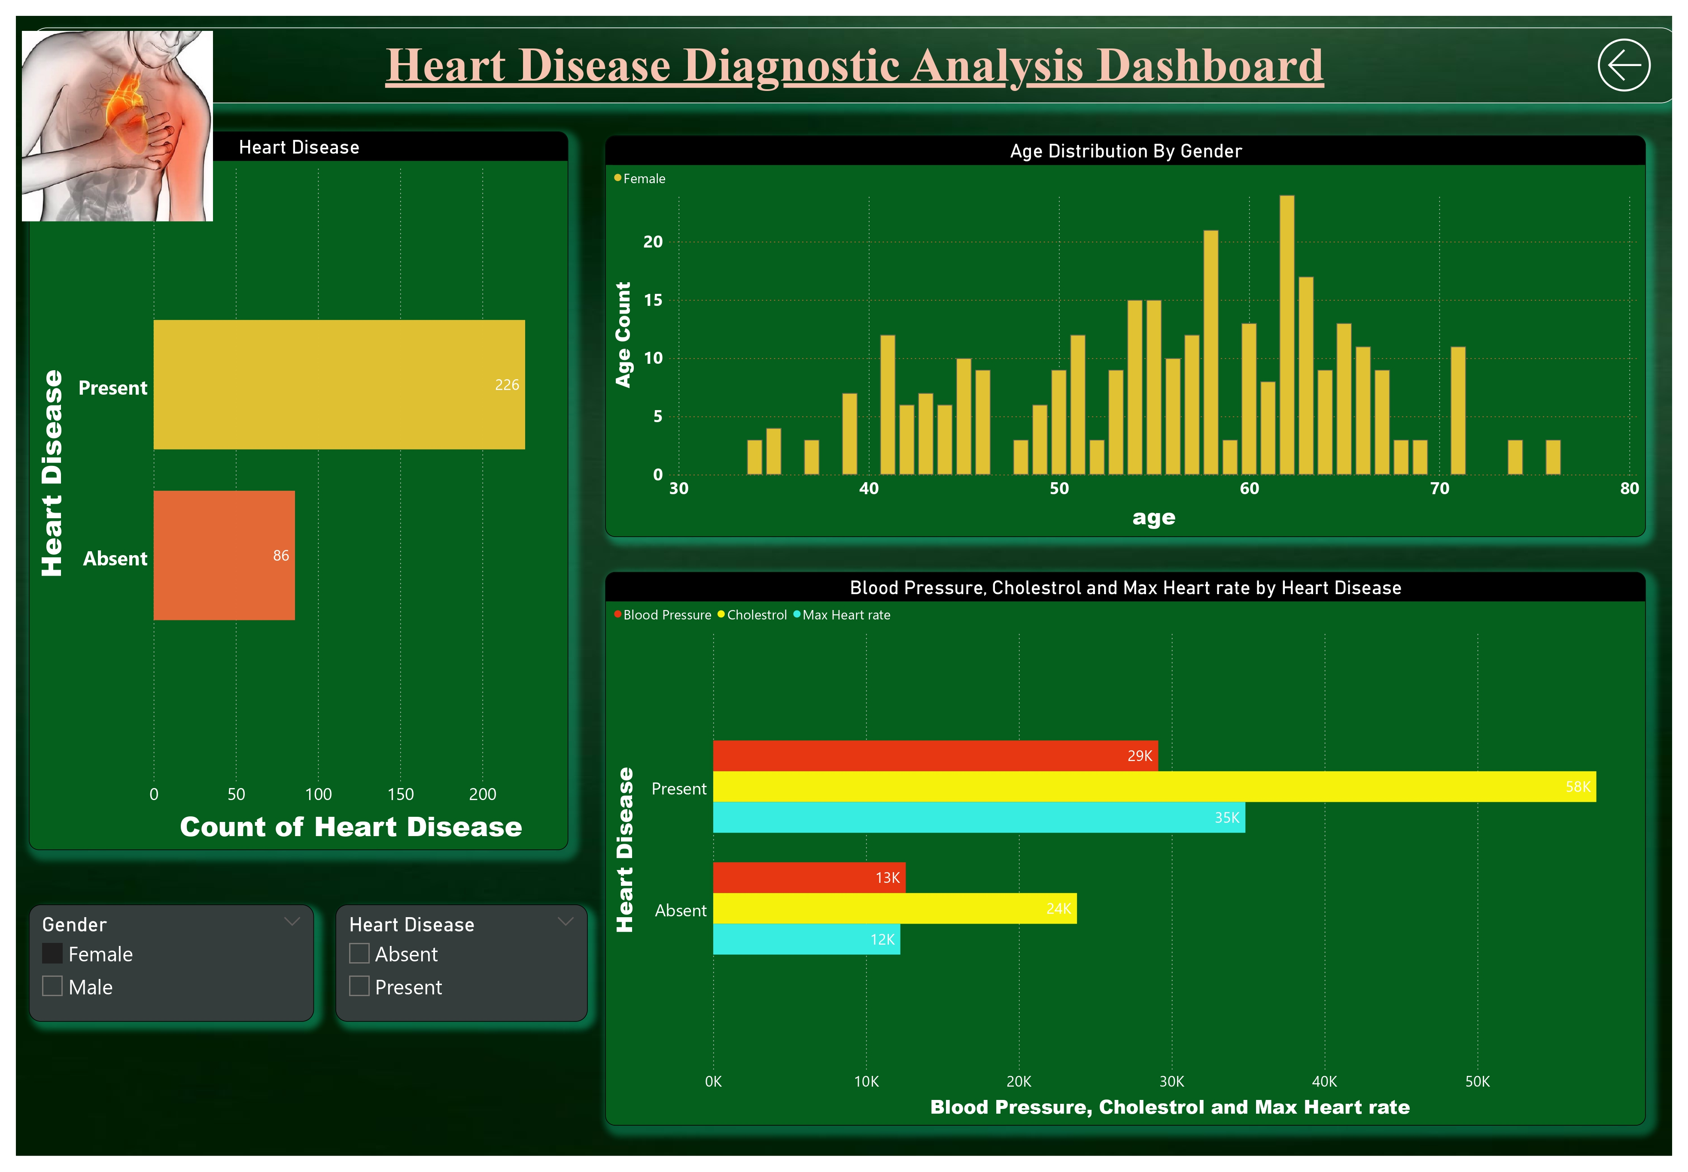
POWER BI DASHBOARD
In this page it is shown in fig Heart Disease Present and absent.
Then What is the age distribution gender wise.
And lastly Blood Pressure Cholestroll and Max Heart rate present in the person who have heart disease .

Slide 4
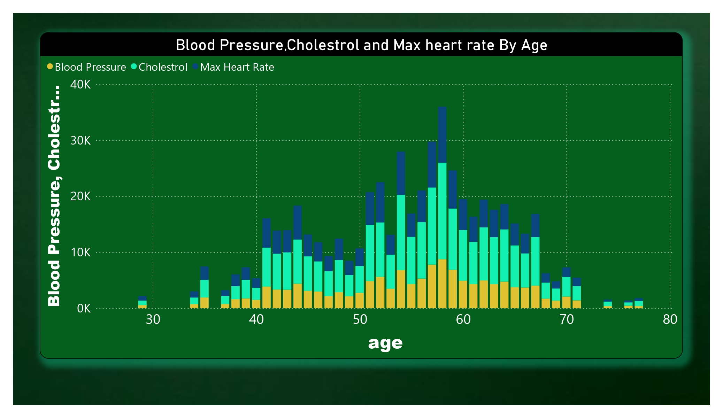
BLOOD PRESSURE , CHOLESTROL AND MAX HEART RATE BY AGE
In this chart we can see which age category has the more number of Blood Pressure Cholestrol and Max Heart Rate as we can see in the graph age 58 has the highest number of BP, Cholestrol and Heart Rate . So we can target more on the age group of 50 to 60.

Slide 5
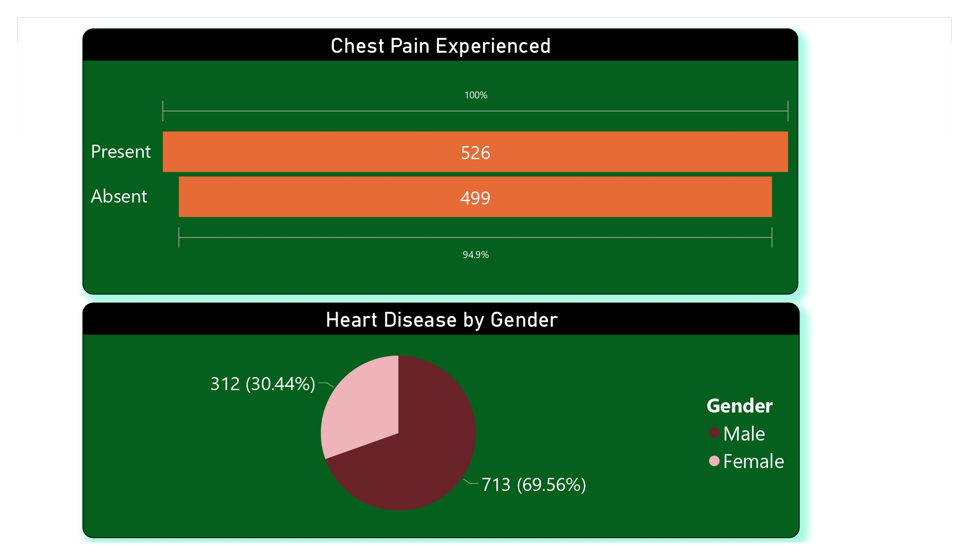
DISTRIBUTION OF HEART DISEASE BY GENDER
In the chart one it it shown that Chest Pain experienced was present in 526 and where as in 499 it was found absent .
IN second chart I have tried to categorize the Heart disease by gender in which I have got that Male have highest number of Heart diseases by 69.56% where as in women it has 30.44%

Slide 6
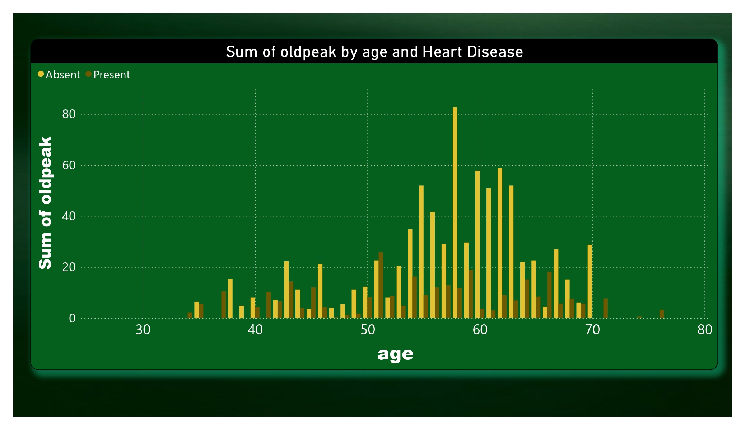
PRESENCE OF OLDPEAK BY GENDER
Data indicates that individuals aged 50- 60 have a nearly equal presence and absence of ST depression (oldpeak) during exercise, suggesting a balanced cardiovascular response in this age group. - In contrast, those aged 55-75 show fewer instances of oldpeak and a higher rate of its absence, possibly reflecting diminished exercise-induced cardiac stress or reduced exercise intensity with increasing age. - These findings highlight the need for age-specific exercise guidelines and cardiovascular screening protocols to better prevent and manage heart disease in different age demographics, optimizing cardiovascular health across the lifespan.

Slide 7
Conclusion
From the overall population, Males having heart disease (69.56%) and Females having heart disease(30.44%).
It seems people having Non-Anginal chest pain have a higher chance of heart disease
We can see that a higher number of men are suffering from Typical Angina type of Chest Pain
Males have high number of Fasting Blood Sugar over 120
Higher Cholestrol Level and Higher Blood Pressure Levelcauses Chances Of Heart Disease

Slide 8
THANK YOU

